Slide 1



INFO1112 Tutorial
Week 12

Slide 2

Homework stuff
Homework 6 – due 29th October, 23:59:00 (this Sunday)
No interview for this homework

Slide 3
Brief summary of this week’s content

Slide 4



What are microservices?
Lightweight services accessible via the Internet
Provide an API to communicate via a protocol
Can be an existing protocol
Can be its own custom application-layer protocol as an extension to the protocol stack

Slide 5
What about APIs?
API stands for Application Programming Interface
Refers to a standardised structure and methodology for 2 programs to communicate with each other
Can standardise communication, e.g. if a client sends some specific data, the server responds with data in a specific format
Primarily used to send and receive data over the Internet whilst hiding the details of how that data is implemented
Can be thought of as “function calls”, with their own parameters and return results

Slide 6
Implementation of APIs
Diversity of APIs means there are a variety of implementations
A common method of using APIs is for a client to package some parameters for a server to obtain some data, with the server responding with the requested data
Web protocols are commonly used for sending/receiving data over APIs
Rather than standard GET requests for a specific web page, a client can send the literal data to communicate with the API implemented by the server, with the server responding with appropriate data as a response
How is data sent over a web protocol?
Make parameters part of URL
Use structured text encoding to represent parameters (by client), and response (by server)
XML (eXtendible Markup Language)
JSON (JavaScript Object Notation)

Slide 7
Examples of sending parameters
service
parameters
Parameters in URL:
https://weatherservice.com/forecast?Sydney&Today
XML
Syntax derived from HTML (uses tags)
No specific structure for tags: defined by implementation
<person>
<name>Frank</name>
<age>30</age>
</person>

Slide 8
Examples of sending parameters
JSON
Syntax matches syntax used for JavaScript literal objects
Works like a Python dictionary, has a string key, and value of various data types
Can be parsed in Python with the built-in json module
{
“name”: “Frank”,
“age”: 30
}

Slide 9
Using APIs in services
Many cloud-service providers offer services which can run as a micro service
Running a function on demand, such as in AWS Lambda, can be used to implement a microservice
API aggregators are organisations which collate micro-services accessible via APIs
Categorise services for specific needs which can be searched for
Provide template code to integrate communication with micro-service API in your own code
Example: RapidAPI (used in lab tasks)

Slide 10
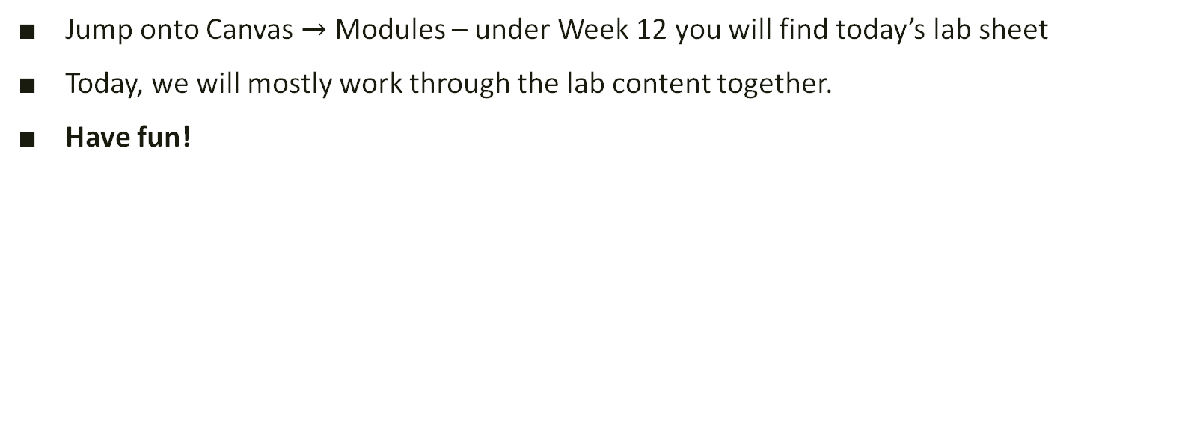
Lab exercises
Jump onto Canvas $→$ Modules – under Week 12 you will find today’s lab sheet
Today, we will mostly work through the lab content together.
Have fun!

Slide 11

Attendance
https://bit.ly/3KuCE2D

Slide 12
Quiz Practice

Slide 13
Week 1 and 2 Content
Write 78 as an 8 bit number
Regarding ASCII text encoding:
what characteristics might be strengths and limitations?
name an alternate encoding used for non-English text.
What component of the operating system is used for interfacing with hardware and software?
Write a shell script to cut the second and third column of a file, and append this to a file called recents.log.
The following output is obtained by running ls -l in the current working directory
total 1
drwxr-xr-x 3 jane wheel 96 10 Aug 10:05 Uni
What information does the highlighted column represent?

Slide 14
Week 3 and 4 Content
The following Python script is run:
import os
import sys
pid = os.fork()
if pid == 0:
print(“Fork successful!”)
sys.exit(0)
else:
print(”Done!”)
sys.exit(0)
What is printed by the parent and child process?
Does this create a zombie process? Justify your reasoning.
What does the /proc folder contain on a Linux system? How do its contents differ from other parts of the file system?
Write a shell script which compares whether file1.txt, file2.txt and file3.txt contain any differences.
If there are no differences, output “No differences”
If all files differ, output “All files differ”
Otherwise, output the files which had differed

Slide 15
Week 5 and 6 Content
Mitchell had been digging around in the garage and found some old CDs which belonged to his parents. The software was designed to run on older Mac OS X computers with a PowerPC processor. Mitchell wants to try this software out on his MacBook with an Intel x86-64 processor.
Should Mitchell use an emulator or a virtual machine for this? Justify your reasoning.
Could a container solution work in this case? Why/why not?
What is the main functionality of the IP protocol, and at what layer does it sit at on the Internet Protocol (TCP/IP) Suite?

Slide 16
Week 7 and 8 Content
The ping command is used to test a connection over the network from a computer
What protocol does the ping command use, and what are its properties?
Nara is trying to ping www.google.com from the University network, but for some reason, the command outputs “Time to live exceeded”. What property/flag can Nara try and use to fix this?
A computer on a private IP address 192.168.0.8 is trying to send a message a data server at public IP address 234.581.0.2, and also receive a response.
The LAN has a maximum of 256 local assignable addresses. Name a technique that can be used to determine if an IP in this LAN is private or public.
What process needs to occur to the private IP address so that it can receive communication from the server?
A computer sends a request to the DNS server to resolve the domain name canvas.sydney.edu.au. Name all servers which might be contacted to resolve this name.

Slide 17
Week 9 and 10 Content
Alice wants to send Bob a message over the Internet that should remain private.
Say that both Alice and Bob have a shared-secret key for encryption/decryption. Name the type of encryption used, and describe the process of sending messages to each other.
Uh oh, Bob has accidentally send the shared-secret key to a colleague by mistake! Alice generates a new key to use.
How can this key be sent confidentially to Bob to allow them to use the same encryption method described in part a)?
Describe the process of signing a message. How might this help ensure authenticity when Alice sends Bob her new key?
Write a Python program that acts as a TCP server. The server will accept requests from clients, one-by-one, and process each in order:
If the client sends “date”, send the current date.
If the client sends “time”, send the current time.
Otherwise, do nothing and disconnect the client.

Slide 18
Week 11 and 12 Content
The X Window System is one implementation of a window server on Unix systems.
Describe the general architecture of the X Window System: how are windows rendered on the screen, and are displayed and interacted with?
What network model does the X Window System resemble?
The Android operating system has a Linux kernel as its base, and has a similar architecture to a Linux PC. What is a key component which differs in how a user interacts with Android compared to a Linux desktop, and how do manufacturers account for this?
Outline some of the similarities and differences between utilising XML and JSON to send data over the Internet through an API.

